Slide 1

G.H.Raisoni College Of Engineering And Management, Pune
(An Empowered Autonomous Institute, Affiliated to SPPU, Pune,
Affiliated by NAAC A+ Grade)
Department of Electronics and Telecommunication Engineering
AI Driven Agribot
REVIEW - 2
Presented by :
Vaibhav Nrupnarayan (A-47)
Harish Bagul (A-24)
Abhiman Bade (A-03)
Guide: Dr. Kavita Joshi

Slide 2
Index
Introduction
Literature Survey
Objectives
Details of the Project
Methodology
Components Used
Project Work Completed
Result Obtained
References

Slide 3

Introduction
Agriculture plays a critical role in the economy, particularly in regions where rice is a staple crop. Traditional rice planting methods are labor-intensive and time-consuming, often leading to inefficiencies and increased costs. To address these challenges, the "Agricultural Rice Plantation Robot using AI & IoT" project aims to develop an innovative solution that automates the rice planting process.
This project leverages Artificial Intelligence (AI) and Internet of Things (IoT) technologies to create a smart, autonomous robotic system capable of performing precise and efficient rice planting. The robot is designed to navigate paddy fields, plant rice seedlings accurately, and monitor environmental conditions in real-time. By integrating AI, the robot can make intelligent decisions to optimize planting patterns and adapt to varying field conditions, ensuring uniform seed distribution, and improving crop yield. IoT sensors will provide continuous data on soil moisture, temperature, and other critical parameters, enabling farmers to make informed decisions about crop management.
The introduction of this robotic system aims to revolutionize rice farming by reducing dependency on manual labor, increasing planting accuracy, and enhancing overall productivity. This project represents a significant step towards modernizing agriculture and ensuring food security through technological innovation.

Slide 4
Literature Survey
Sr.no | Paper Name | Name of Publisher | Publishing Year | Methodology | Result
1 | Smart farming for improving agricultural management | Elsevier | 2021 | Here the cloud based event and data management is done using the cloud system, connecting the different sensors to the cloud and analyse the collected data. | Collection of the data and analyzing it for the future procedure on the crops on the fields according to the quality of the plants.
2 | Application of AI techniques and robotics in agriculture | Elsevier | 2023 | Normal application of AI in detecting the trees, leaves and other factors like detecting the fruits and quality by using image processing and neural network topology, raspberry Pi and the display | Detecting the objects in the fields using AI and deciding the objects.

Slide 5
Sr. no | Paper Name | Name of Publisher | Publishing Year | Methodology | Result
3 | Design and development of the agricultural robot for crop seeding | IJAIEM | 2014 | Here the fully functional agricultural mini robot is made which can drop the seeds automatically into the fields with the help of Arduino, IR sensor, ultrasonic sensor and motors. | The seed of the plant can be sowed without the human requirements with this automated seed planter robot.
4 | Detection of unhealthy region of plant leaves using Image Processing and Genetic Algorithm | IEEE | 2015 | 1. Artificial neural network (ANN) 2. CIELAB color model 3. Color co-occurrence method with SVM classifier | An ANN based classifier classifies different plant diseases and uses the combination of textures, color and features to recognize those diseases. It is used to remove that noise. The training samples can be increased and shape feature and color feature along with the optimal features can be given as input condition of disease identification.

Slide 6
Sr.no | Paper Name | Name of Publisher | Publishing Year | Methodology | Result
5 | Effect for a Paddy Weeding Robot in Wet Rice Culture | Fuji Technology Press | 2018 | 1. Navigation Algorithm (PWM control as the basic navigation control) 2. Capacitive touch sensors 3. Azimuth sensor | The ground is uneven, and the rows of rice seedlings are not always straight, as is the case in terraced paddies. It is used to detect rice seedlings and Measure the movement direction.
6 | Robotics and Automation in Agriculture: Present and Future Applications | ARQII Publication | 2020 | 1. Real-Time Kinematic GPS (RTK-GPS) and IMU 2. Fuji F660EXR Camera 3. Normalized Different Spectral Indices (NDSI) | This new technology is used for position and attitude sensor for navigation system. To monitor the seed falling trajectories which is attached at the Unissem pneumatic planter outlet. It is used in detecting peanut leaf spots.

Slide 7
Objectives
Main Objective:
Specific Goals:
Implement Rice plantation Agribot to Reduce labour costs and manual errors.
Achieve a improvement in rice quality through AI-driven crop quality control measures.
Identify potential issues after specific period from the day plantation to spray the fertilizers before the crucial impact on the crop.
Develop an, Agribot, machinery to sow the rice plant and enhance the quality of rice plantation through crop quality detection.

Slide 8
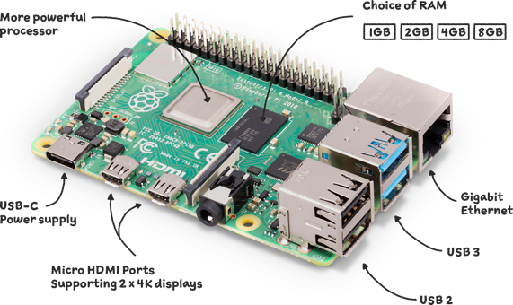
Detail of the Project :
1. Raspberry PI 4 Model B
Working Principle
Microcomputer: Functions like a small desktop PC.
System on Chip (SoC): Broadcom BCM2711 integrates CPU, GPU, memory, and I/0 controllers.
Operating System: Typically runs on Raspberry Pi OS (Linux based).
GPIO Pins: Allows interfacing with other hardware components
Specifications
Processor: Quad-core Cortex-A72 (ARM v8) 64-bit SoC @ 1.5GHz or 1.8GHz.
Memory: 1GB, 2GB, 4GB, or 8GB LPDDR4-3200 SDRAM
Wireless: 2.4 GHz and 5.0 GHz IEEE 802.11ac, Bluetooth 5.0, BLE
Ethernet: Gigabit Ethernet.
USB Ports: 2 USB 3.0 and 2 USB 2.0 ports.
Video Output: 2 micro-HDMI ports supporting up to 4Kp60.
Storage: Micro-SD card slot.
Power Supply: 5V DC via USB-C connector (minimum 3A).
Other Ports: MIPI DSI display port, MIPI CSI camera port, 4-pole stereo audio and composite video port.

Slide 9
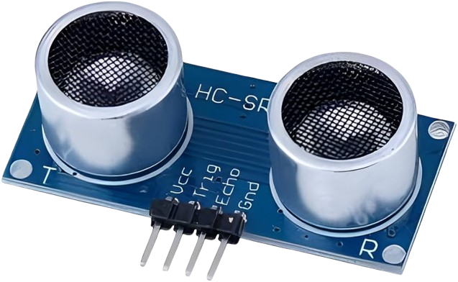
2. Ultrasonic Sensor (HC-SR04)
Working Principle
The trigger pin sends a 10 us pulse to emit ultrasonic waves at 40 kHz.
The sensor transmits an 8-cycle burst of ultrasonic sound waves.
When these waves hit an object, they reflect back to the sensor.
The echo pin receives the reflected waves, and the sensor calculates echo pin receive the distance based on the time difference between sending and receiving the pulse.
Specifications
1. Operating Voltage: 5V DC, Operating Current: 15 mA.
2. Ultrasonic Frequency: 40 kHz, with a measuring range of 2 cm to 400 cm.
3. Accuracy: ±3 mm, with a measuring angle of 15 degrees.
4. Trigger Pulse Duration: 10 us, Echo Pulse Output proportional to distance measured.

Slide 10
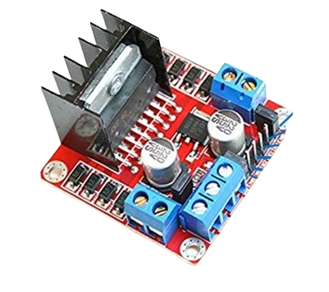
3. DC Motor Driver(L298N)
Working Principle
The L298N motor driver controls the direction and speed of DC motors by managing the voltage supplied to them.
It operates based on an H-Bridge circuit, which allows the current to flow in both directions, enabling forward and reverse motor motion.
By using PWM (Pulse Width Modulation), the speed of the motor can be controlled by adjusting the duty cycle of the voltage.
The driver can control two motors independently, allowing for bidirectional movement and speed control in applications like robotics.
Specifications
Operating Voltage: 5V to 35V, Current Rating: 2A per motor.
Can control 2 DC motors or 1 stepper motor.
Logic Voltage: 5V, with logic current of 36 mA.
Dual H-Bridge configuration, allowing for independent control of two motors.

Slide 11
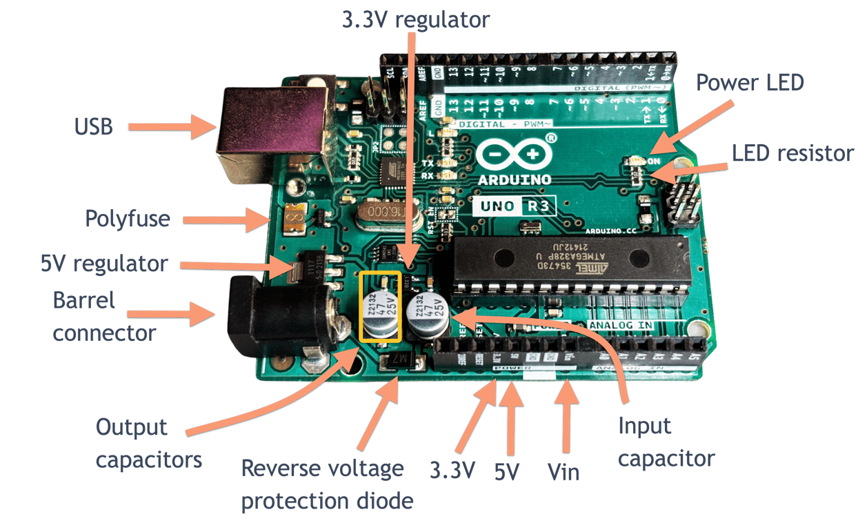
3. Arduino Uno R3
Working Principle
Microcontroller (ATmega328P): Executes instructions from stored programs.
Input/Output (I/O) Pins: Interfaces with external devices (sensors, actuators, etc.).
Analog-to-Digital Converter (ADC): Converts analog signals to digital data.
Pulse Width Modulation (PWM): Generates analog signals from digital data.
Serial Communication: Enables communication with computers, other Arduino boards, or devices.
Specifications
Hardware:
Microcontroller: ATmega328P2.
Operating Voltage: 5V3.
Input Voltage: 7-12V4.
Flash Memory: 32 KB5.
SRAM: 2 KB6.
EEPROM: 1 KB7.
Clock Speed: 16 MHz
I/O Pins:
1.Digital I/O Pins: 14 (6 PWM), 2. Analog Input Pins: 6, 3. Analog Output Pins: 0 (PWM), 4. UART (RX/TX): 1, 5. SPI: 1, 6. I2C: 1

Slide 12
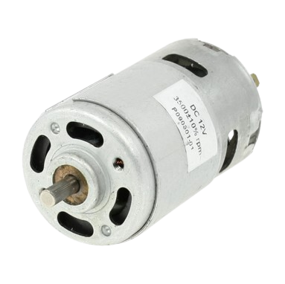
4. DC Motor
Working Principle
Basic Components: A PMDC motor consists of a stator (the stationary part), which has permanent magnets, and a rotor (the rotating part), which contains windings.
Current Flow: When a voltage is applied across the motor terminals, current flows through the windings of the rotor. The direction of this current creates a magnetic field around the rotor.
Interaction with Stator Magnets: The magnetic field generated by the rotor interacts with the magnetic field of the permanent magnets in the stator. This interaction produces a torque that causes the rotor to rotate.
Commutation: The motor typically has a commutator and brushes that ensure the current direction in the rotor windings changes at appropriate intervals, allowing continuous rotation. As the rotor turns, the commutator switches the current direction, maintaining torque in the same rotational direction.
Speed Control: The speed of a PMDC motor can be adjusted by varying the voltage applied to the motor. Increasing the voltage increases the current, which raises the torque and speed.
Specifications
Voltage Rating: 12V DC
Current Rating: 0.3A (rated current)
Speed: 3500 RPM (revolutions per minute)
Connector Type: 2 Pin Connector
Motor Type: Cylindrical Permanent Magnet DC Motor
Torque Characteristics: Typically rated at a specific torque, often in terms of oz-in or Nm, depending on the application

Slide 13
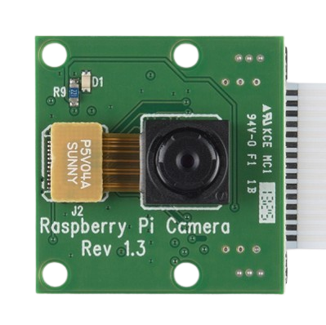
5. Raspberry Pi 8 MP Camera Module
Working Principle
The camera module connects to the Raspberry Pi's CSI (Camera Serial Interface) port, enabling high-quality image and video capture.
It utilizes an 8MP sensor for capturing still images and videos, making it ideal for applications like image processing and object detection.
The camera feeds data directly to the Raspberry Pi, where it can be processed by software, such as Al or machine learning models, for tasks like crop quality analysis.
The module supports video recording in multiple resolutions and still images with a resolution of 3280 x 2464 pixels.
Specifications
1. Resolution: 8 Megapixels (3280 x 2464 for still images).
2. Video Support: 1080p at 30fps, 720p at 60fps, 640x480p at 90fps.
3. Lens: Fixed-focus, supports a wide range of lighting conditions.
4. Interface: Connects via CSI connector on the Raspberry Pi, using the dedicated camera interface.

Slide 14


Methodology
System Design:
Components:
Data Collection and Integration (Sensors, Data Aggregation)
AI and Analytics Engine(Machine Learning Models, Output Dashboard)
Hardware
Software
Data Collection
Data Processing and Storage
AI and Analytics Engine

Slide 15

Begin
Hardware Architecture:
First loading of seedlings
Here is the architecture of the hardware which the rice planter will work and the different actions will be taken by the machine.
Drive mechanism with Motor
Using Slider crank mechanism for Arm
Planting the rice plant
End

Slide 16
Block diagram of the Hardware Circuit.
Sensors
Raspberry Pi
Motor Controller (Controlling the action of robot and planting the seedlings with robotic arm)

Slide 17
Software Architecture:
Input image
Here is the block diagram of the software with which we can detect the quality of the rice plant. The Machine Learning is used to detect the difference between the good quality product and the bad quality product.
Image preprocessing
Image segmentation
Feature extraction
Data base
Training Model
Classification
Display output on the laptop screen

Slide 18
Components Used :
Raspberry Pi 4 - Model B (4 GB ram)
Arduino mini
12V geared DC motors 2
1.2mA 12v Battery pack.
12 Voltage regulator.
L293D motor Driver.
Ultrasonic Sensor.
IR colour sensor.
8 MP camera
5V Servo motor

Slide 19
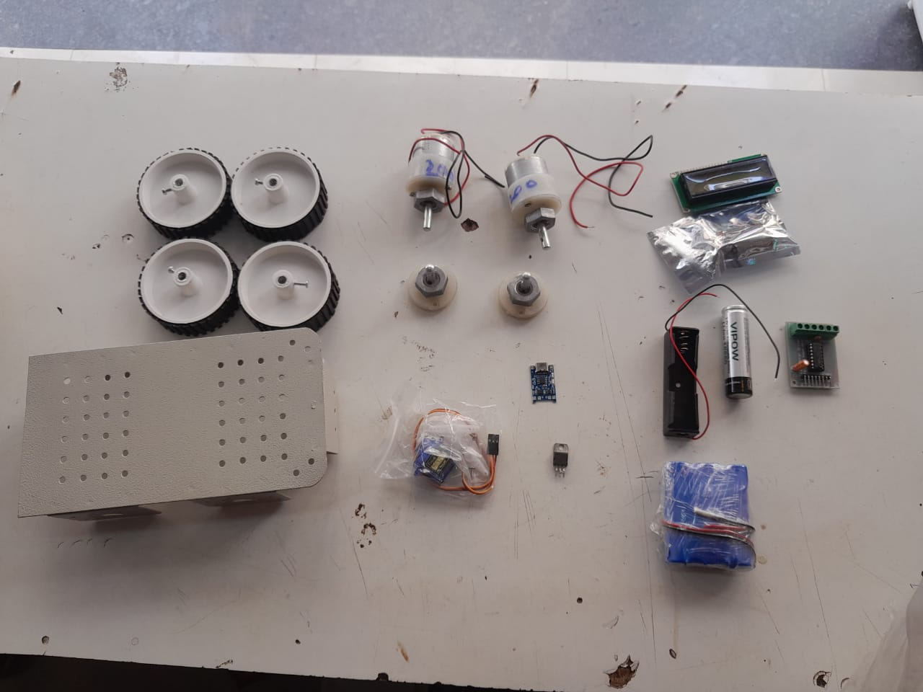
Components Used :

Slide 20
Project Work Completed Upto Date:
Developing machine learning models for crop quality detection.
Progress made towards identifying crop health issues, but full functionality is still under development.
Created the schematic for motors integrated with motor driver and raspberry pi.
Generated the Code for the controlling motors with Motor controller with raspberry Pi.

Slide 21
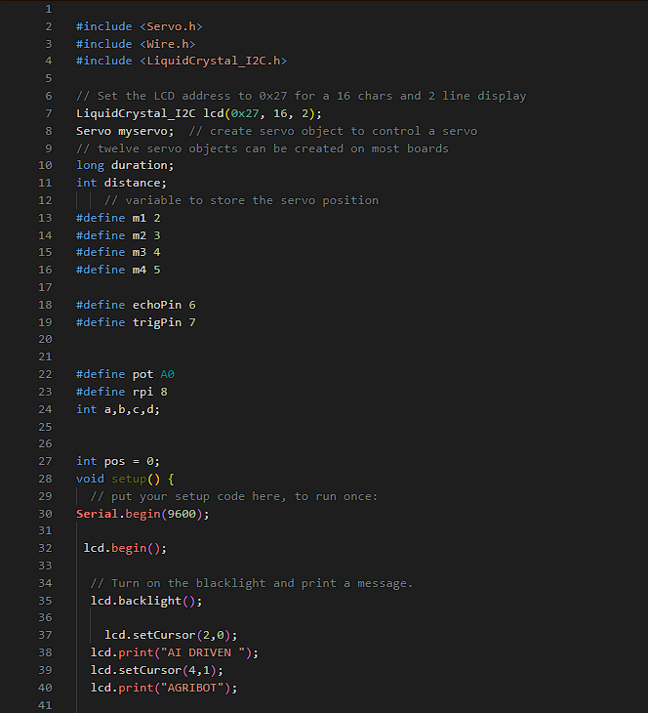
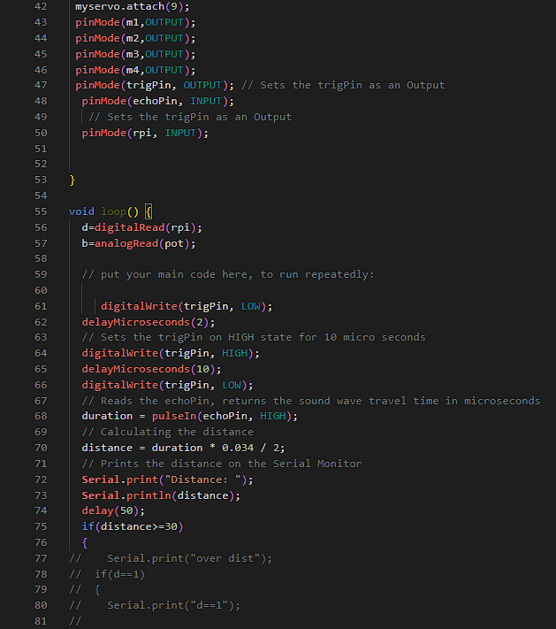
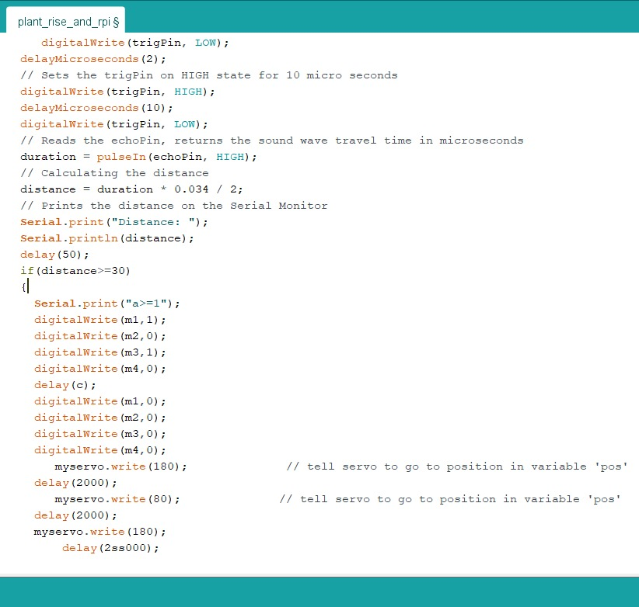
Code For Hardware:

Slide 22
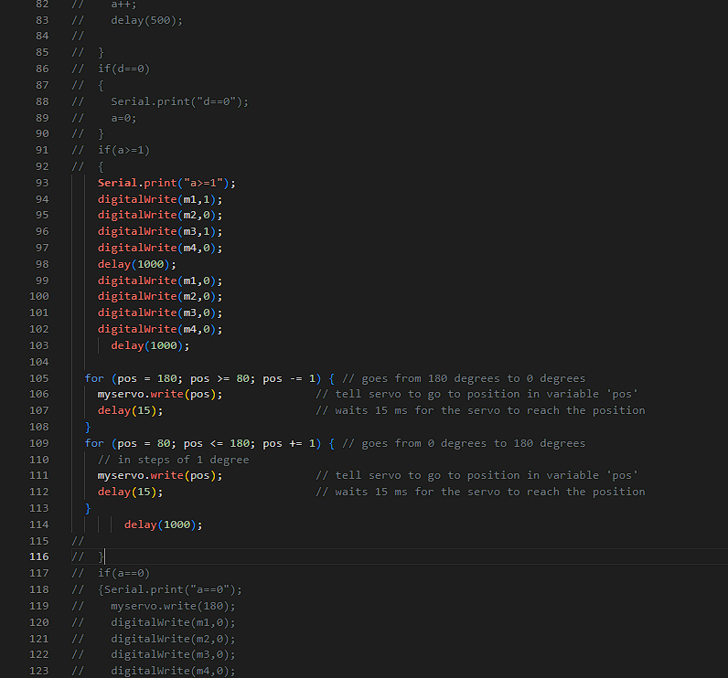
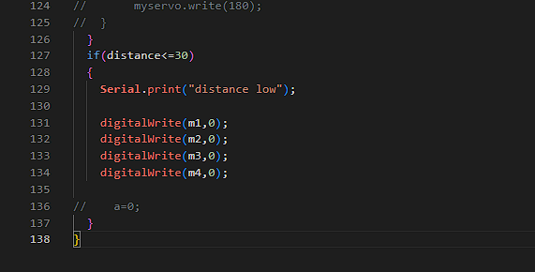

Slide 23
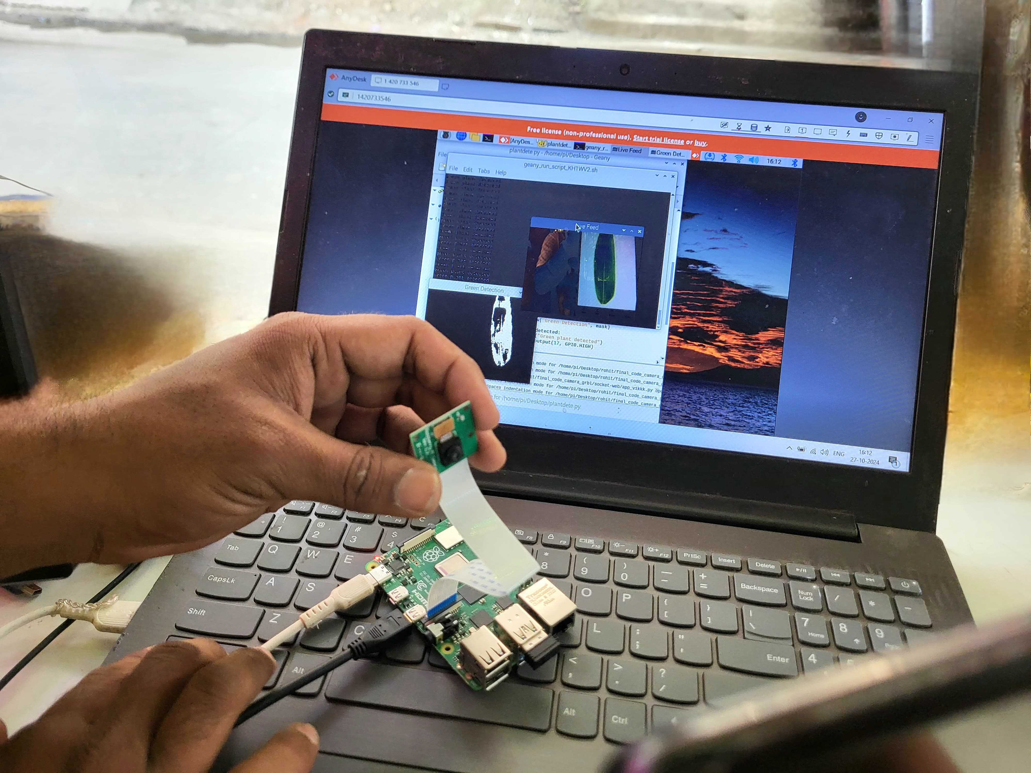
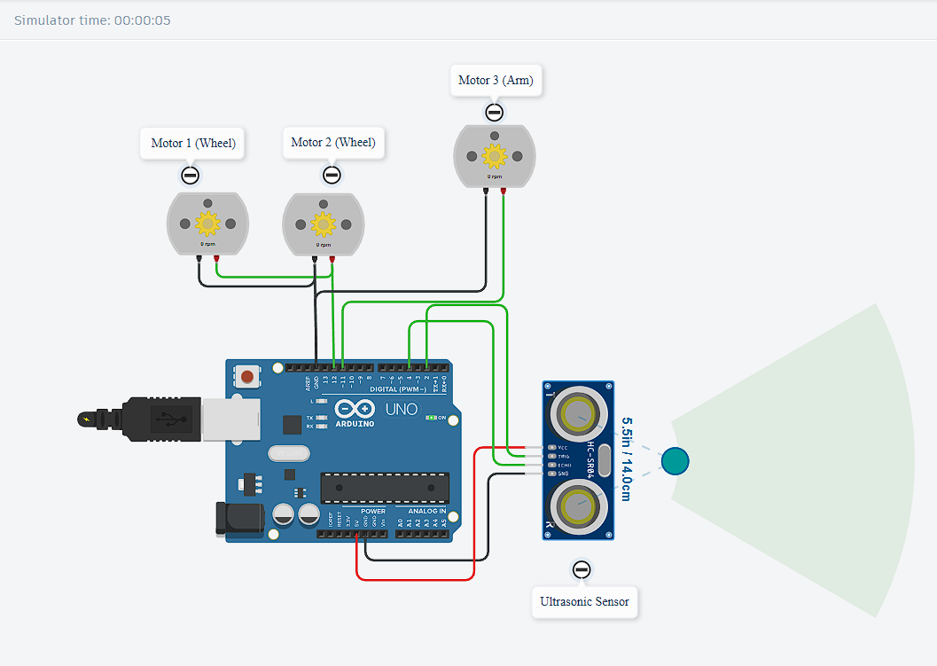
Result obtained :
If Object distance is under 30 cm

Slide 24
Conclusion
Agribot aims to revolutionize rice farming by utilizing data monitoring to optimize crop quality and promote sustainable practices. By addressing the inefficiencies and challenges in traditional rice farming, Agribot seeks to improve yields and achieve high-quality production while ensuring environmental stewardship. The machine learning model is still under development and requires important changes.

Slide 25
References
[1] Hitoshi Sori, Hiroyuki Inoue, Hiroyuki Hatta, and Yasuhiro Ando. ‘‘Effect for a Paddy Weeding Robot in Wet Rice Culture’’. Japan. February 27, 2018.
[2] Elsayed Said Mohamed, Sameh Kotb Abd-Elmabod, Mohammed A El-Shirbeny, Mohamed B Zahran. ‘‘Smart farming for improving agricultural management’’. Egypt, 2019.
[3] Prabira Kumar Sethya, Nalini Kanta Barpandaa, Amiya Kumar Rathod, Santi Kumari. “Image Processing Techniques for Diagnosing Rice Plant Disease”. India.
[4] Muhammad Junaid Asif, Tayyab Shahbaz, Dr. Syed Tahir Hussain Rizvi, Sajid Iqbal. “Rice Grain Identification and Quality Analysis using Image Processing based on Principal Component Analysis”, Pakistan, 2018.
[5] Pramod Kumar Sahoo, Dilip Kumar Kushwaha, Nrusingh Charan Pradhan, Yash Makwana, Mohit Kumar, Mahendra Jatoliya, Arjun Naik, Indra Mani, “ROBOTICS APPLICATION IN AGRICULTURE”, India,2022.
[7] Mohd Saiful Azimi Mahmud, Mohamad Shukri Zainal Abidin, Abioye Abiodun Emmanuel and Hameedah Sahib Hasan, “Robotics and Automation in Agriculture: Present and Future Applications”,Malaysia, April 2020.
[8] Vijai Singh Asst Professor, Varsha Asst Professsor, Prof. A K Misra, “Detection of unhealthy region of plant leaves using Image Processing and Genetic Algorithm”, India, 2015.
[9] K. Tamaki, Y. Nagasaka, K. Nishiwaki, M. Saito, Y. Kikuchi, K. Motobayashi, “A Robot System for Paddy Field Farming in Japan”, Japan, 2013.

Slide 26
Thank You

